Slide 1
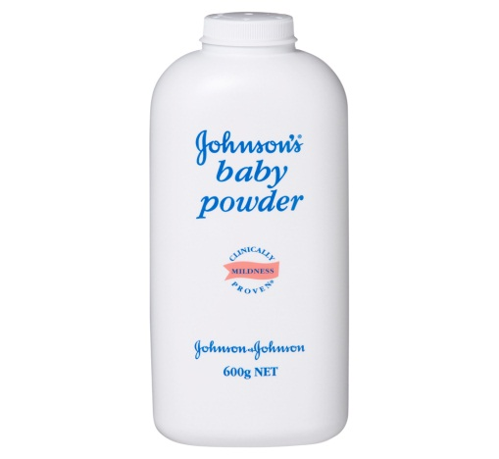

Quality Control. Project Owner CMB Head
J and J Talcum Powder reported without fragrance.
Routine cross examine of talcum powder # BV60195,dated 17/03/2016 found no fragrance.
Inform to Baddi Olfactory team, material already dispatched.
Asked for control sample , control sample found Acceptable.
Both the samples “control” and “routine test sample” shown to CMB Head Mr. Pratyaya Chakrabarti and Mr. Sunil Sing

